Slide 1
刚体物理
韩红雷
中国传媒大学 动画学院

Slide 2
复习
如何建一个“PhysX物理仿真”工程
如何构造各种类型的刚体
如何使用已有代码完成绘制等
如何实现交互

Slide 3
本课内容
让角色休眠、皮肤宽度
静止角色、运动学角色
冻结、阻尼
碰撞组
CCD
局部力、力模式

Slide 4
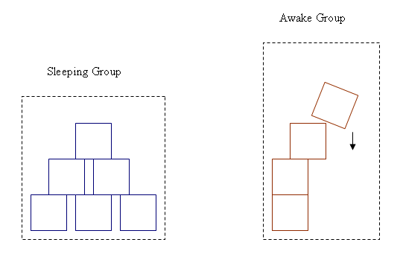
角色休眠
当一个物体在一定时间内不移动的时候，可以认为它将保持这种不移动状态，直到外力改变
在有外力之前，将不对其进行仿真以便节约时间
把这种状态叫做sleeping
Notes:
When a body does not move for a period of time, it is assumed that it will remain immobile until an external force throws it out of equilibrium. Until this force happens, it is no longer simulated in order to save time. This state is called sleeping.

Slide 5
角色休眠
控制角色休眠
  setSleepLinearVelocity
  setSleepAngularVelocity
Notes:
When a body does not move for a period of time, it is assumed that it will remain immobile until an external force throws it out of equilibrium. Until this force happens, it is no longer simulated in order to save time. This state is called sleeping.
In previous versions of PhysX, a body that was not moving for a certain time was considered sleeping and would not be integrated. When all bodies in an island had fallen asleep, they were pulled out of the simulation. In 2.5 and later, bodies will only be considered as being asleep when the whole island they’re in wants to fall asleep. This means that bodies that have not moved for some time may still be awake, if they are in the same island as something that is moving. However, when the whole island falls asleep, it is taken out of the simulation totally.
Note that bodies that are put to sleep have their velocities set to zero, even if they were not exactly zero before.
The length of time over which the SDK judges an object to be sleeping is defined by the constant NX_SLEEP_INTERVAL. Each body has a sleep counter which is decremented each step based on if the body is determined to be awake(eg a force applied). When the counter reaches zero the body becomes a candidate to sleep.
The counter is specified by the body desc member:
NxBodyDesc::wakeUpCounter

Slide 6
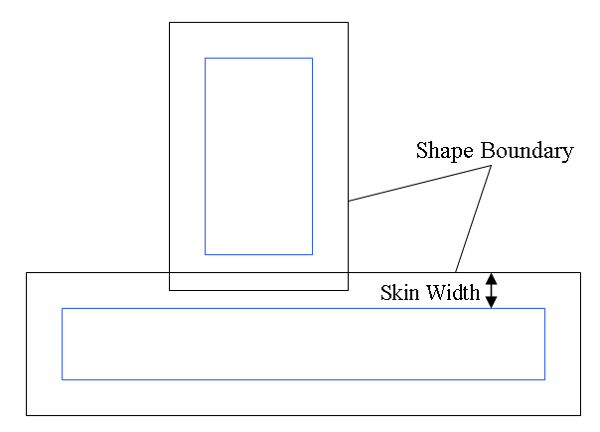
皮肤宽度
制定碰撞检测的容差
没有容差的话，容差过大结果都不好
  前者在没有碰撞的情况下会被判断为碰撞
  gPhysicsSDK->setParameter(NX_SKIN_WIDTH, 0.1);
  void NxShape::setSkinWidth(NxReal skinWidth);
  void NxShape::getSkinWidth();
Notes:
The simulation deals with inaccuracy when stacking objects by letting them slightly inter penetrate each other. The amount of permitted inter penetration can be regulated at a scene level using the NX_SKIN_WIDTH parameter. Clearly, a lot of inter penetration is visually undesirable. On the other hand, forbidding inter penetration is even worse, because objects may repel each other to the point where they separate, and then fall back down on each other in a subsequent time frame. This leads to visible jittering. The amount of inter penetration that is best permitted depends on many things such as the size of the objects involved (so that the inter penetrating region is visually negligible) but also on the stability of the simulation, which is usually governed by the gravity setting as well as the time step size. (Lower gravity and smaller time steps typically result in more stable simulations.)

Slide 7
练习
角色休眠的概念
如何设置和角色休眠相关的参数
皮肤宽度的概念
如何设置皮肤宽度

Slide 8
冻结
是对角色在位置或者旋转上施加的约束
  比如保证角色在一定的高度或者不能旋转
禁止重力也是一种刚体约束
raiseBodyFlag(NX_BF_FROZEN_POS_X);
Notes:
In this lesson you will learn about freeze flags and linear and angular damping. Freeze flags are rigid body flags meant to constrain components of an object’s position and rotation, like making sure the object stays at a particular height or is unable to rotate about a particular axis. Disabling gravity is another rigid body flag we will see that makes the actor unaffected by gravity.
Linear and angular damping help stop moving objects that, in the absence of friction, constraints, or collisions, would otherwise continue to travel indefinitely. In a realistic simulation, there is usually a certain measure of air resistance. Doing without linear and angular damping can lead to results that play unrealistically, with objects travelling perpetually, moving without resistance farther than they would normally in an everyday environment.

Slide 9
阻尼
使用阻尼可以让运动更真实
比如空气阻力等
setLinearDamping(0.5);
setAngularDamping() ；
Notes:
Linear and angular damping help stop moving objects that, in the absence of friction, constraints, or collisions, would otherwise continue to travel indefinitely. In a realistic simulation, there is usually a certain measure of air resistance. Doing without linear and angular damping can lead to results that play unrealistically, with objects travelling perpetually, moving without resistance farther than they would normally in an everyday environment.

Slide 10
练习
设定不同的冻结属性以便满足游戏中的要求
使用阻尼和不使用阻尼的区别

Slide 11
碰撞组
setGroup
setGroupCollisionFlag(1,2,true);
可以将某个shape或者角色设置为不同的组
不同组之间可以设置是否发生碰撞
Notes:
This training program teaches you about collision groups. A collision group is used to mark collections of shapes in the scene as collidable with none, some, or all other collision groups. All shapes start out in collision group 0 by default.
Collision groups are useful for turning collision off for groups of shapes you don’t want colliding with other groups of shapes. You can also use collision groups to turn off certain groups of shapes you want to ignore when casting a ray through the scene.

Slide 12
练习
如何设置不同的碰撞组
碰撞组在游戏中的用途

Slide 13
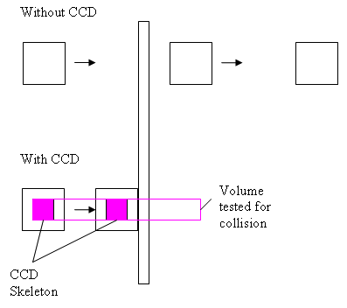
CCD
快速移动物体和其他物体之间碰撞检测的判断
可以利用在快速移动物体移动路径上构造一个体的方式和其他物体求交来实现
Notes:
为了

Slide 14
局部力
到目前为止，我们都是使用全局空间的力和力矩，施加于角色的质心
可以使用局部定义的力施加到角色上

Slide 15
力模式
NX_FORCE NX_IMPULSE NX_VELOCITY_CHANGE NX_SMOOTH_IMPULSE NX_SMOOTH_VELOCITY_CHANGE NX_ACCELERATION

Slide 16
练习
如何利用局部力来控制物体
如何操作力模式

